Slide 1


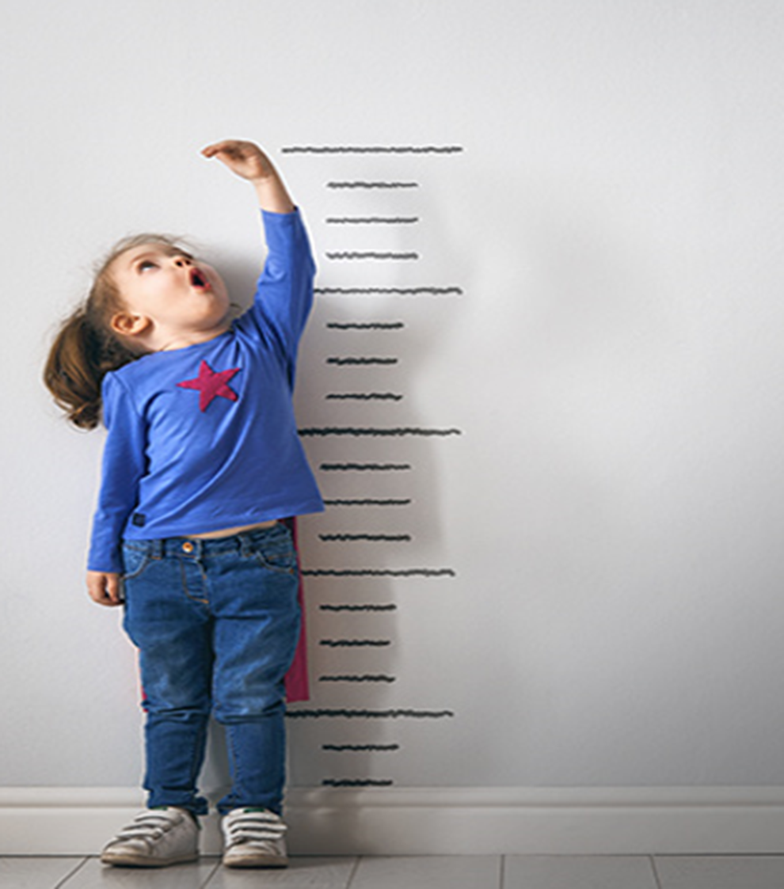


FTTell
Diagnosis failure to thrive among children
Capstone Project Phase A -24-1-D-3
Sabeel Hamood : 211581343
Ehsan Sarboukh : 209002534
Supervisor:
Dr. Natali Levi-Soskin

Slide 2

What is Failure To Thrive?
FTT (Failure to Thrive) is a medical term used to describe inadequate weight gain or inadequate weight loss in children or infants, indicating inadequate growth and development.
FTT can be diagnose among all different ages of children.

Slide 3
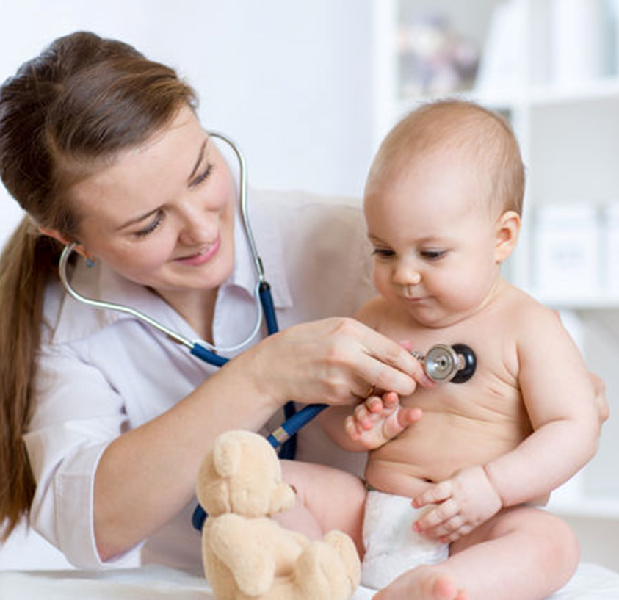


Problem
• The FTT diagnosis process is lengthy and may lead to various medical complications for the patient due to delayed identification and treatment.
. Despite standardized quantitative definitions, FTT can be overlooked or misdiagnosed.

Slide 4
Existing Solutions
Most used methods
•Growth Monitoring.
•Medical History and Physical Examination.
•Nutritional Assessment.
•Psychosocial Evaluation.
Rourke Baby Record (RBR)
•Developed in Canada is a comprehensive tool for growth monitoring but is not used for diagnosing FTT.

Slide 5


The Research

Slide 6
Research-FTT
Diagnosis of FTT requires consideration beyond weight and height (BMI calculation), including genetics and environment.
Facial recognition reveals psychosocial condition, offering insights into the child's environment.
Additional assessments: Head circumference (HC), allergic (type 3), genetic factors (parents' weight and height) are essential for comprehensive evaluation.

Slide 7
Research-CV
Using Computer Vision for FTT Diagnosis in Children:
Computer vision analyzes facial expressions to detect emotional cues in children diagnosed with Failure to Thrive (FTT).
By recognizing signs of emotional distress or discomfort, FER technology aids in early diagnosis of FTT, enabling timely intervention and treatment.
FER provides an objective method for assessing emotional well-being, complementing traditional diagnostic approaches and improving patient care.

Slide 8


Research-AI

Slide 9

Our Solution
FTTell

Slide 10



Frontend Technologies

Slide 11


Backend Technologies
Express js

Slide 12


AI-Tool Chatgpt

Slide 13
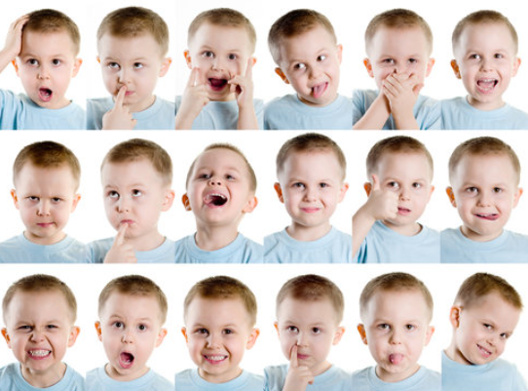

Computer Vision

Slide 14
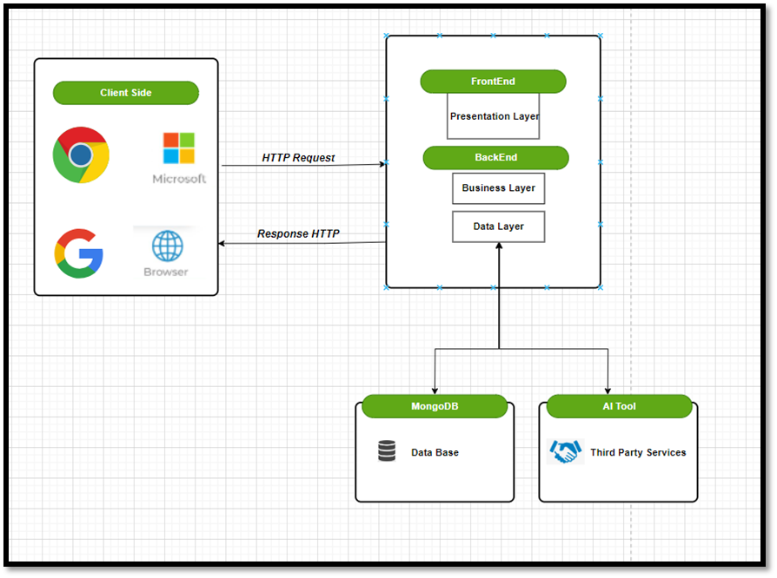
Architecture Overview
3-Tier

Slide 15
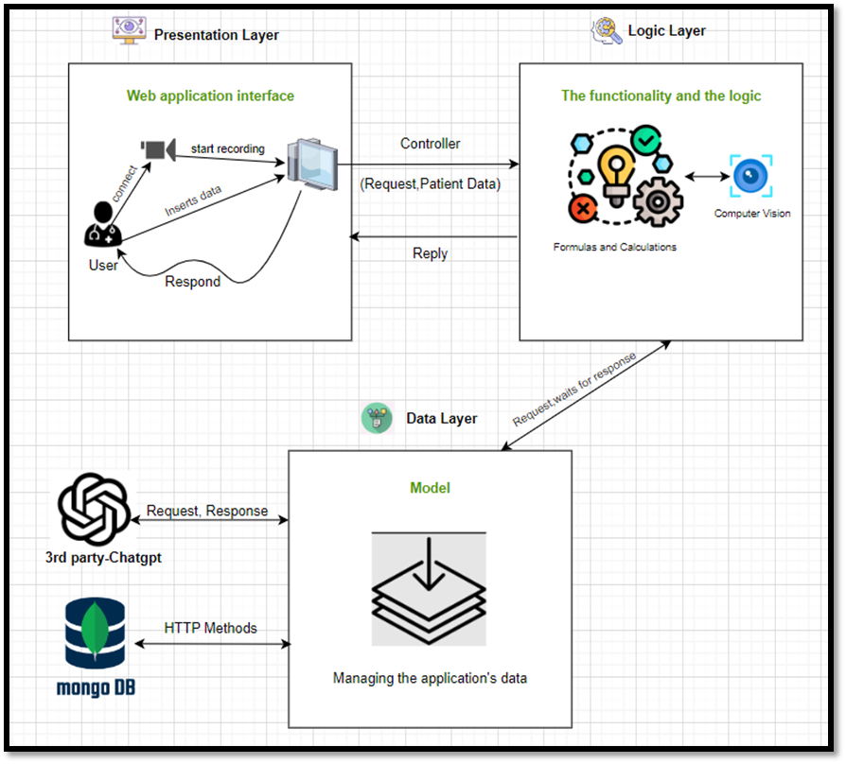
MVC - Architecture

Slide 16
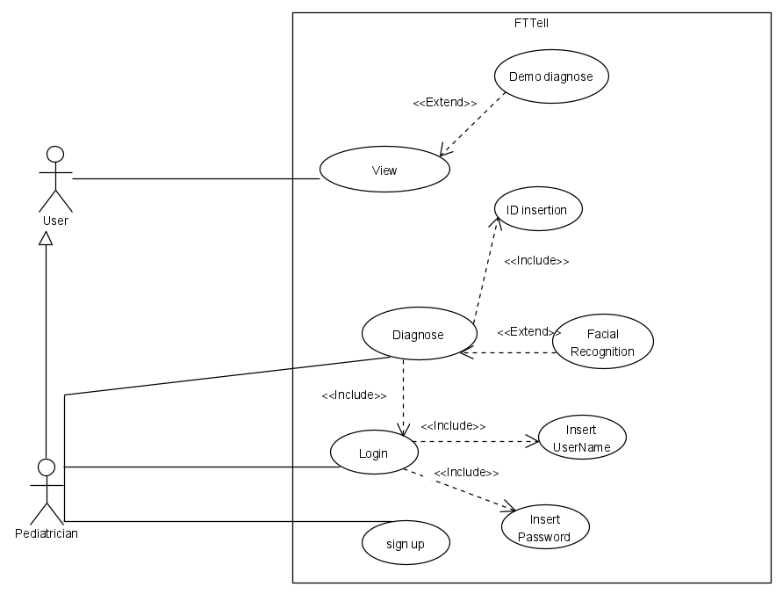
Use Case

Slide 17
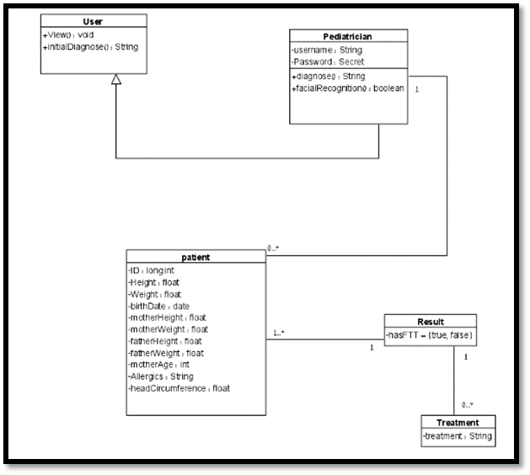
Class Diagram

Slide 18
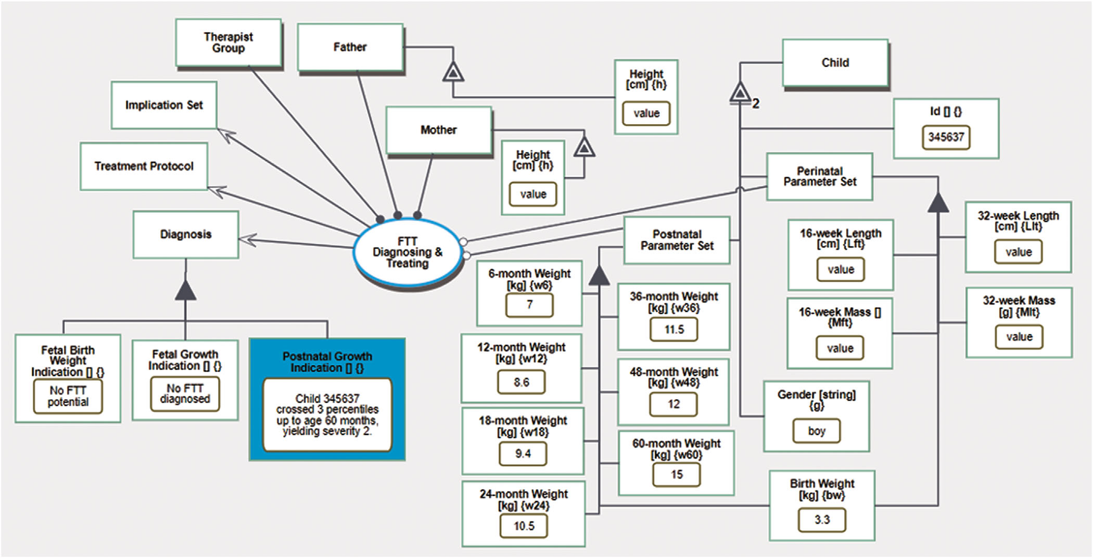
OPM
Levi‐Soskin, N., Yasin, F., Dori, D., & Shaoul, R. (2023). Model‐based diagnosis with FTTell: Diagnosing early pediatric failure to thrive. Systems Engineering.

Slide 19


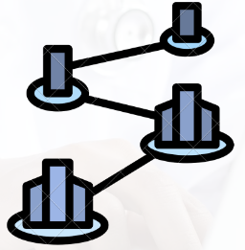

What makes us unique ?
User Friendly
Estimated Accuracy
90% +
Early diagnoses
Scalability

Slide 20

Simulation
FTTell

Slide 21
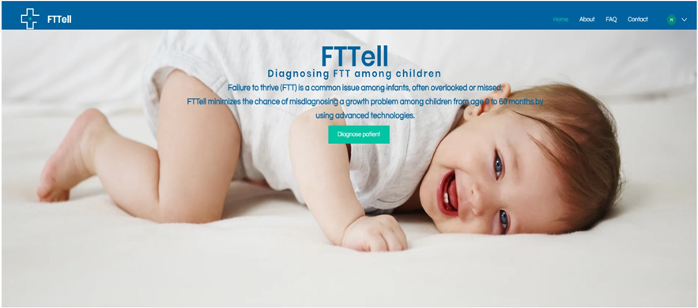
Simulation

Slide 22
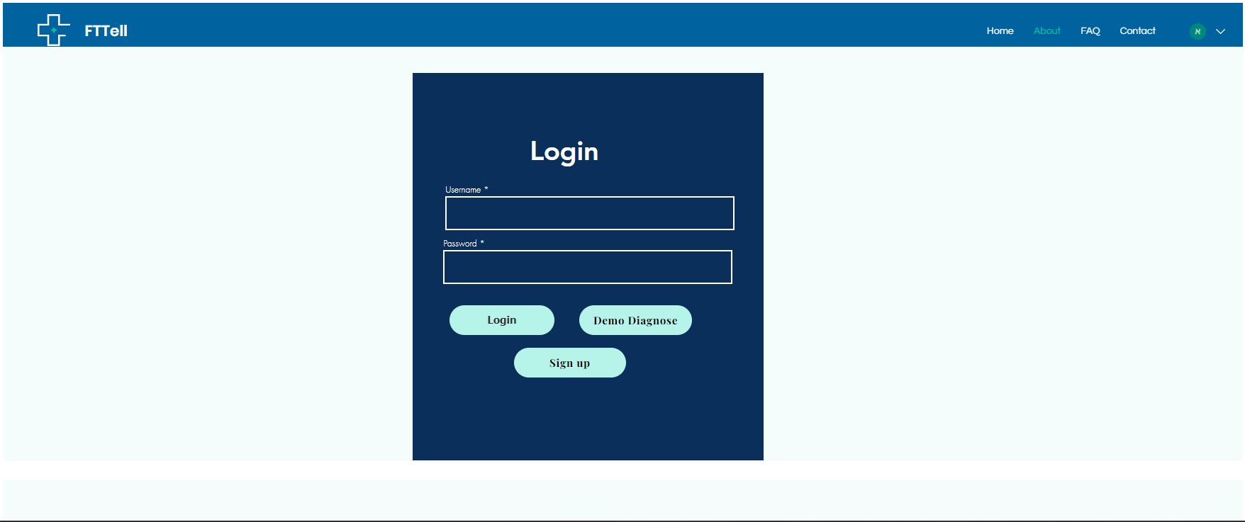
Simulation

Slide 23
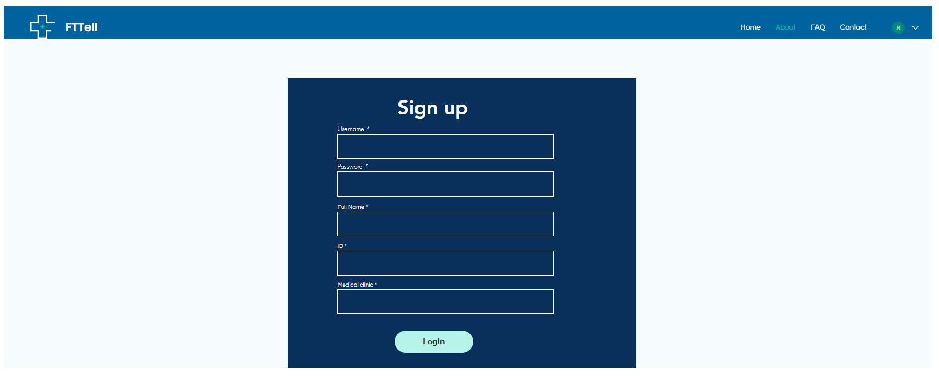
Simulation

Slide 24
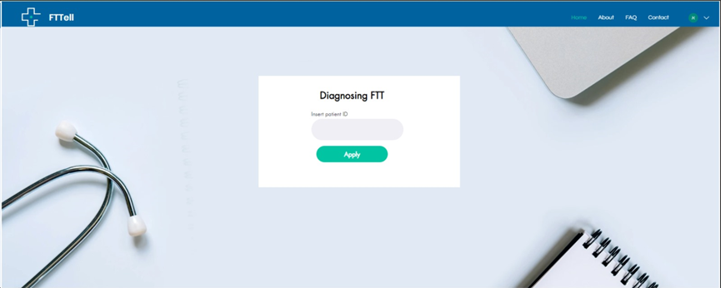
Simulation

Slide 25
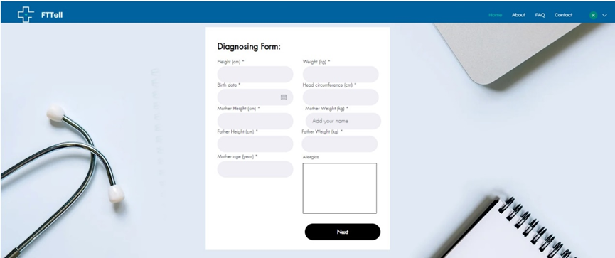
Simulation

Slide 26
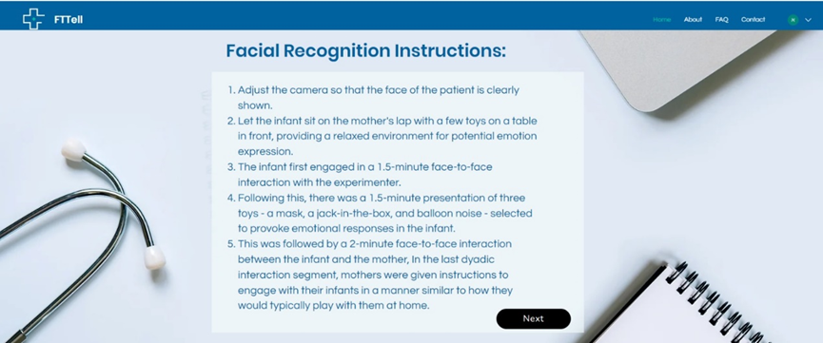
Simulation

Slide 27
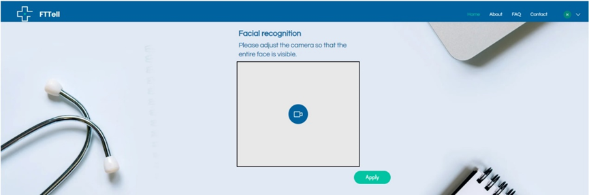
Simulation

Slide 28
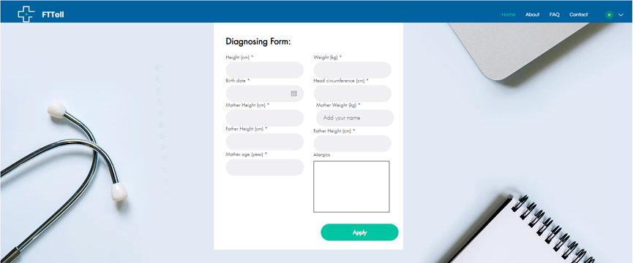
Simulation

Slide 29
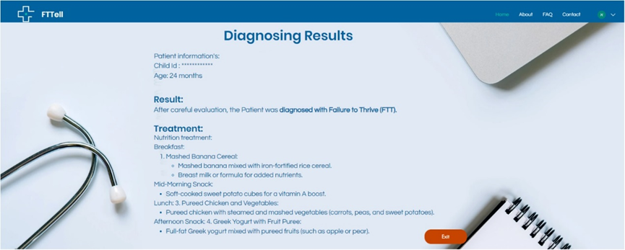
Simulation

Slide 30
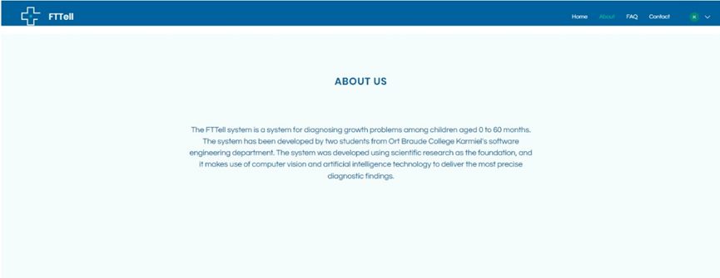
Simulation

Slide 31
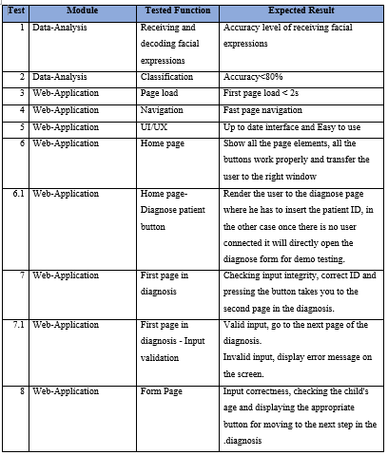
Testing Plan

Slide 32
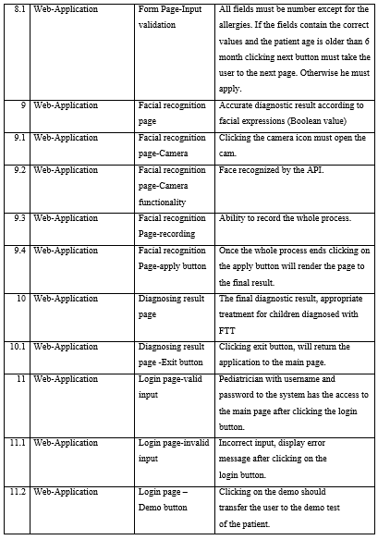
Testing Plan

Slide 33
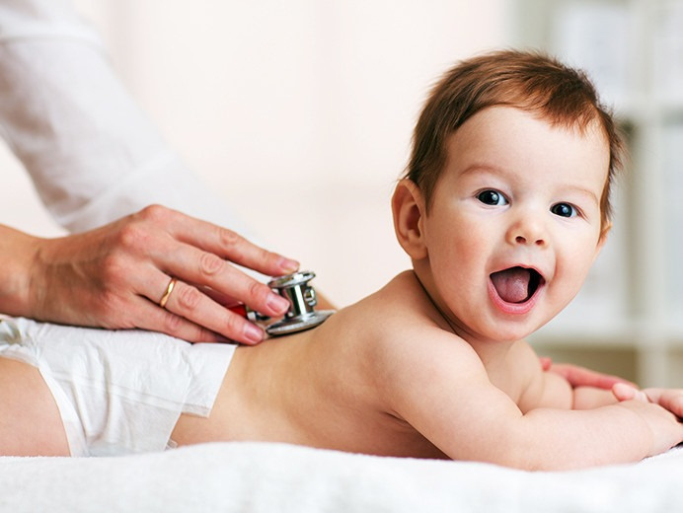
Thank
You.
For Your Attention

